Slide 1
Wipro Capstone Project Presentation
Capstone Project: Automated Testing on Demoblaze
Tools Used: Eclipse, Java Selenium, Maven, TestNg, Github, Jenkins, Jira-Zephyr
Name: Harshit Kumar
Email: harshit892000@gmail.com
Superset id: 2688764

Slide 2
Project Overview
Objective
Automate testing workflow for Demoblaze website.
Ensure end-to-end functionality from user signup to order confirmation.
Scope of Automation
Authentication: Signup & Login
Shopping Flow: Product Selection & Cart Management
Checkout: Payment & Order Confirmation

Slide 3
Project Tools & Technologies
Eclipse IDE
Selenium WebDriver
Maven
TestNG
Git/GitHub
Jenkins
JIRA + Zephyr

Slide 4
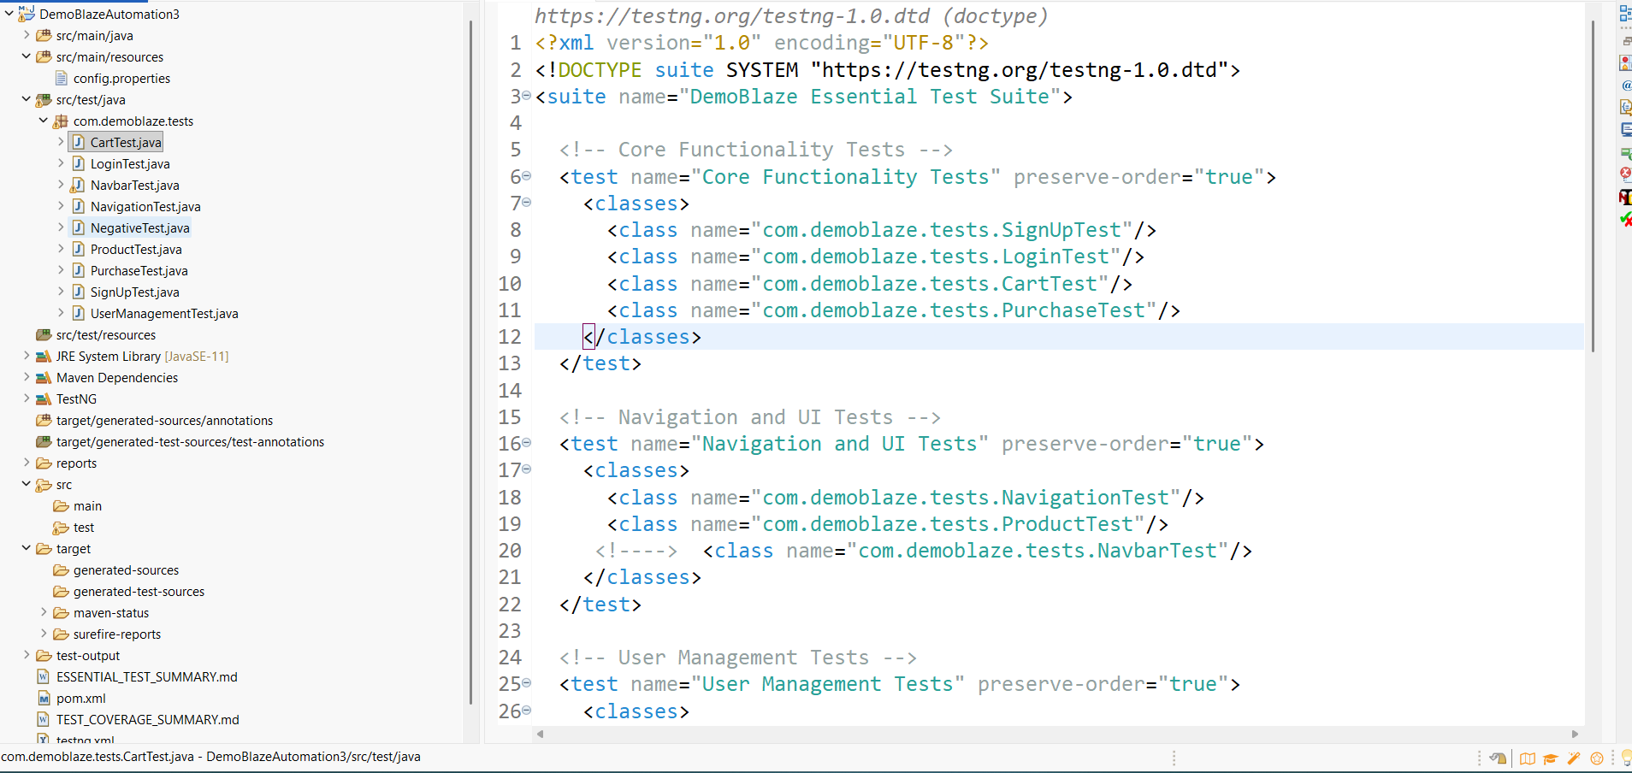
Test Workflow
1. User Registration
2. User Login
3. Navigate Categories
4. Select Product
5. Add Product to Cart
6. Place Order & Verify Confirmation
Folder Structure

Slide 5
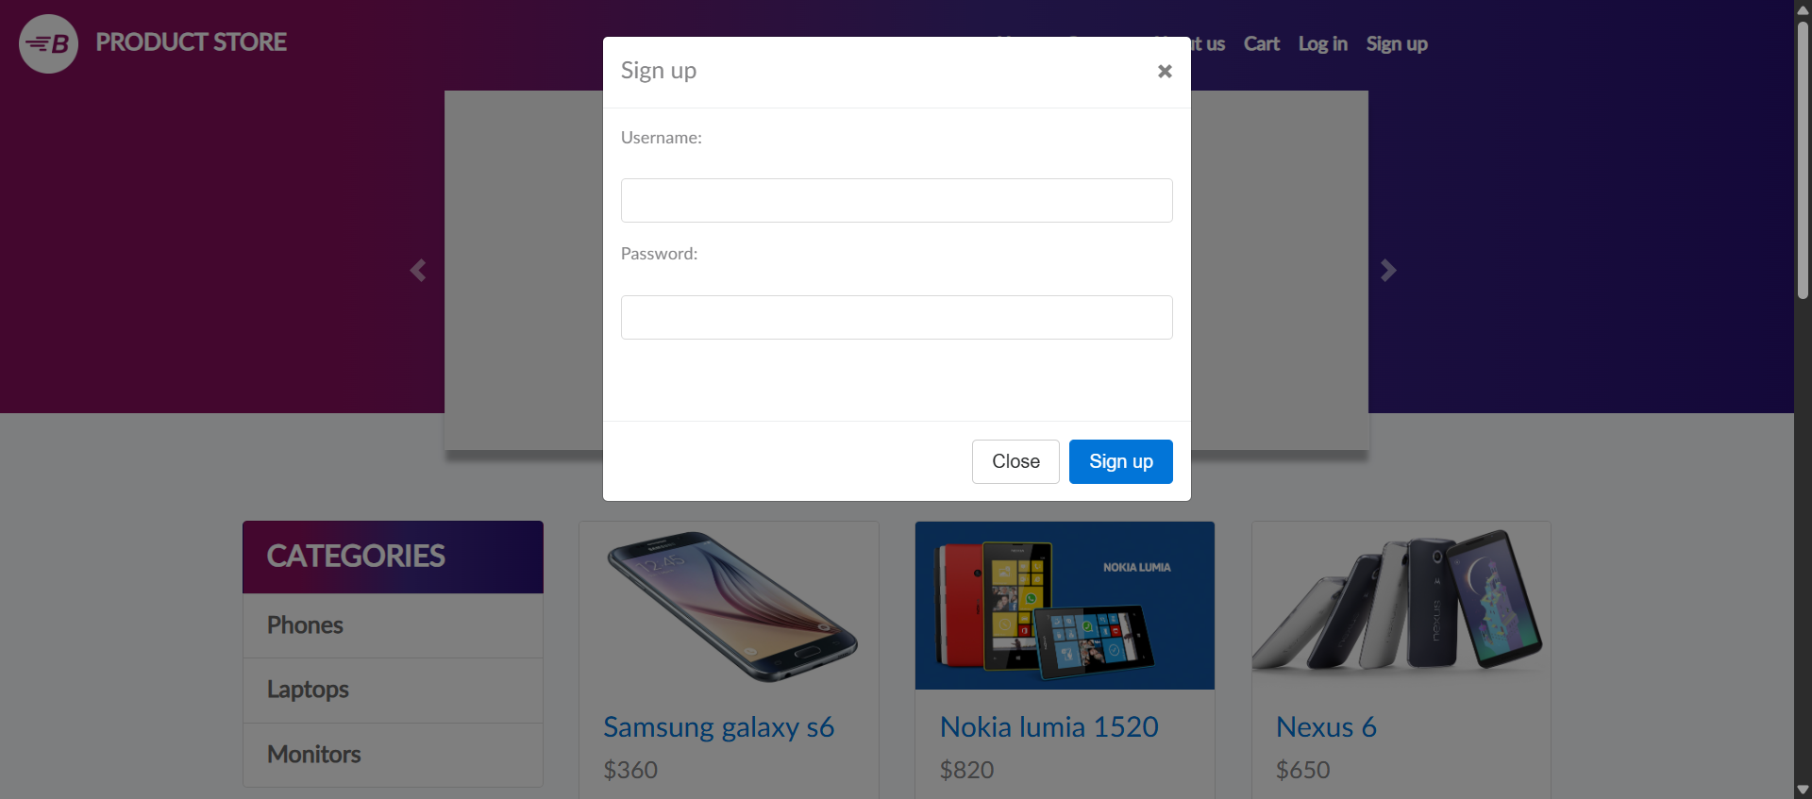
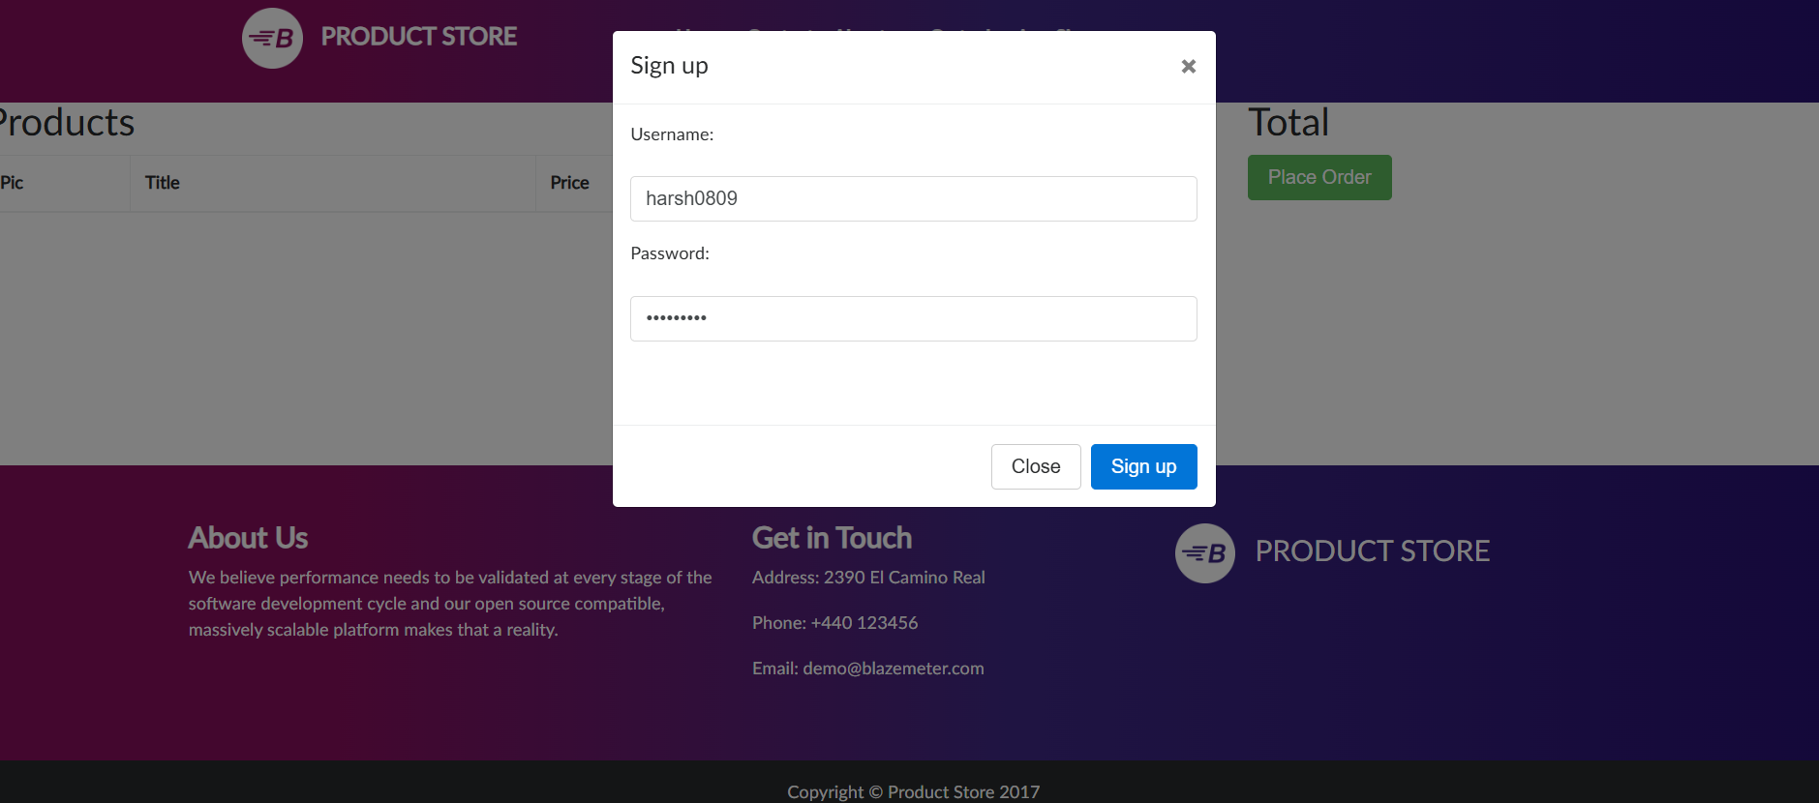
User Registration
Objective:
Verify account creation functionality.
Steps: Navigate → Sign up → Enter details → Submit.
Expected: Account created successfully.

Slide 6
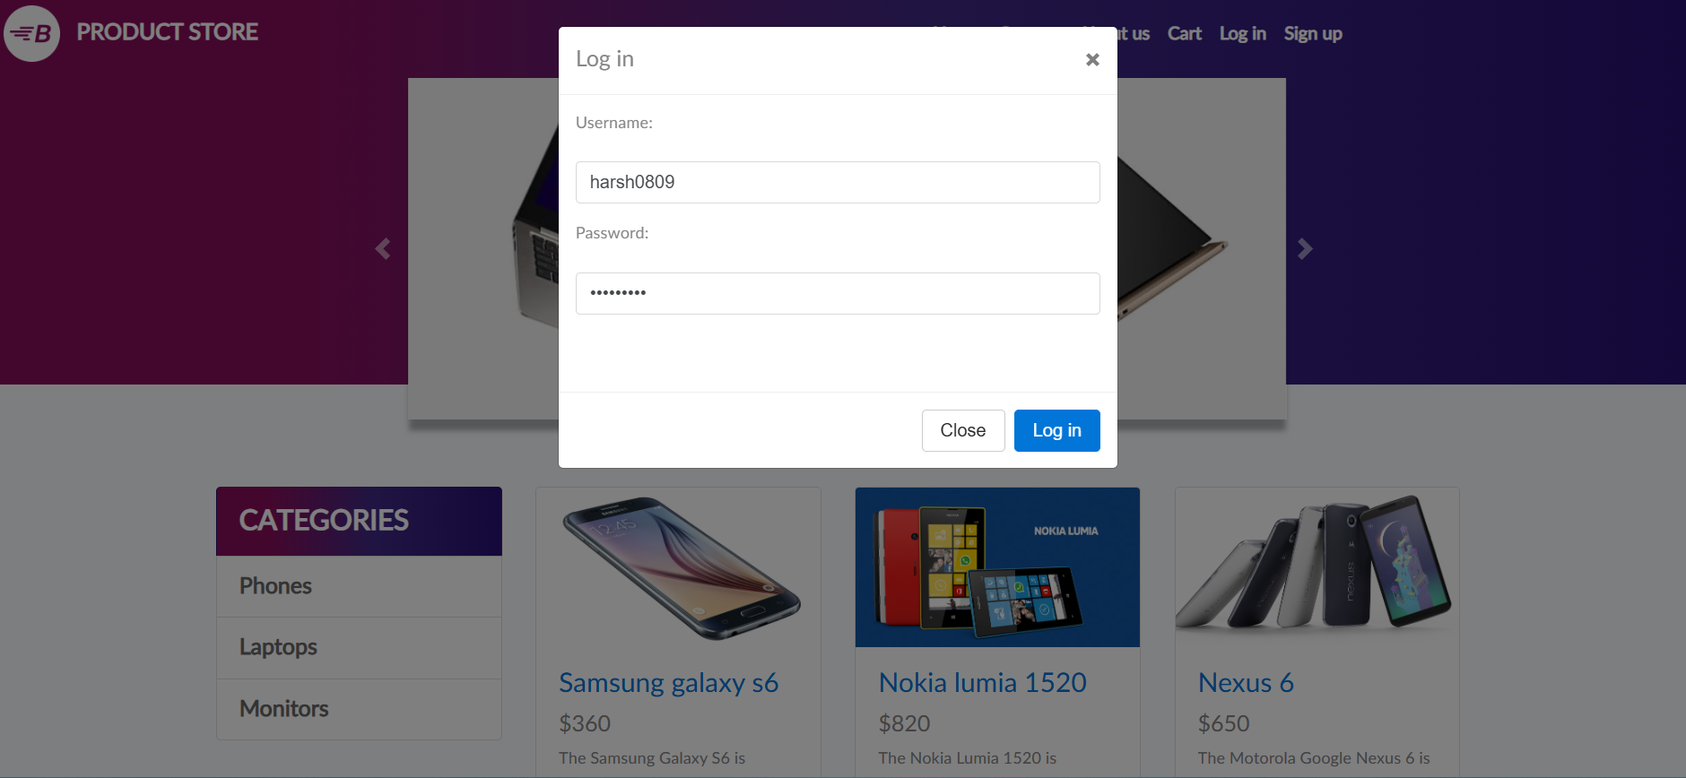
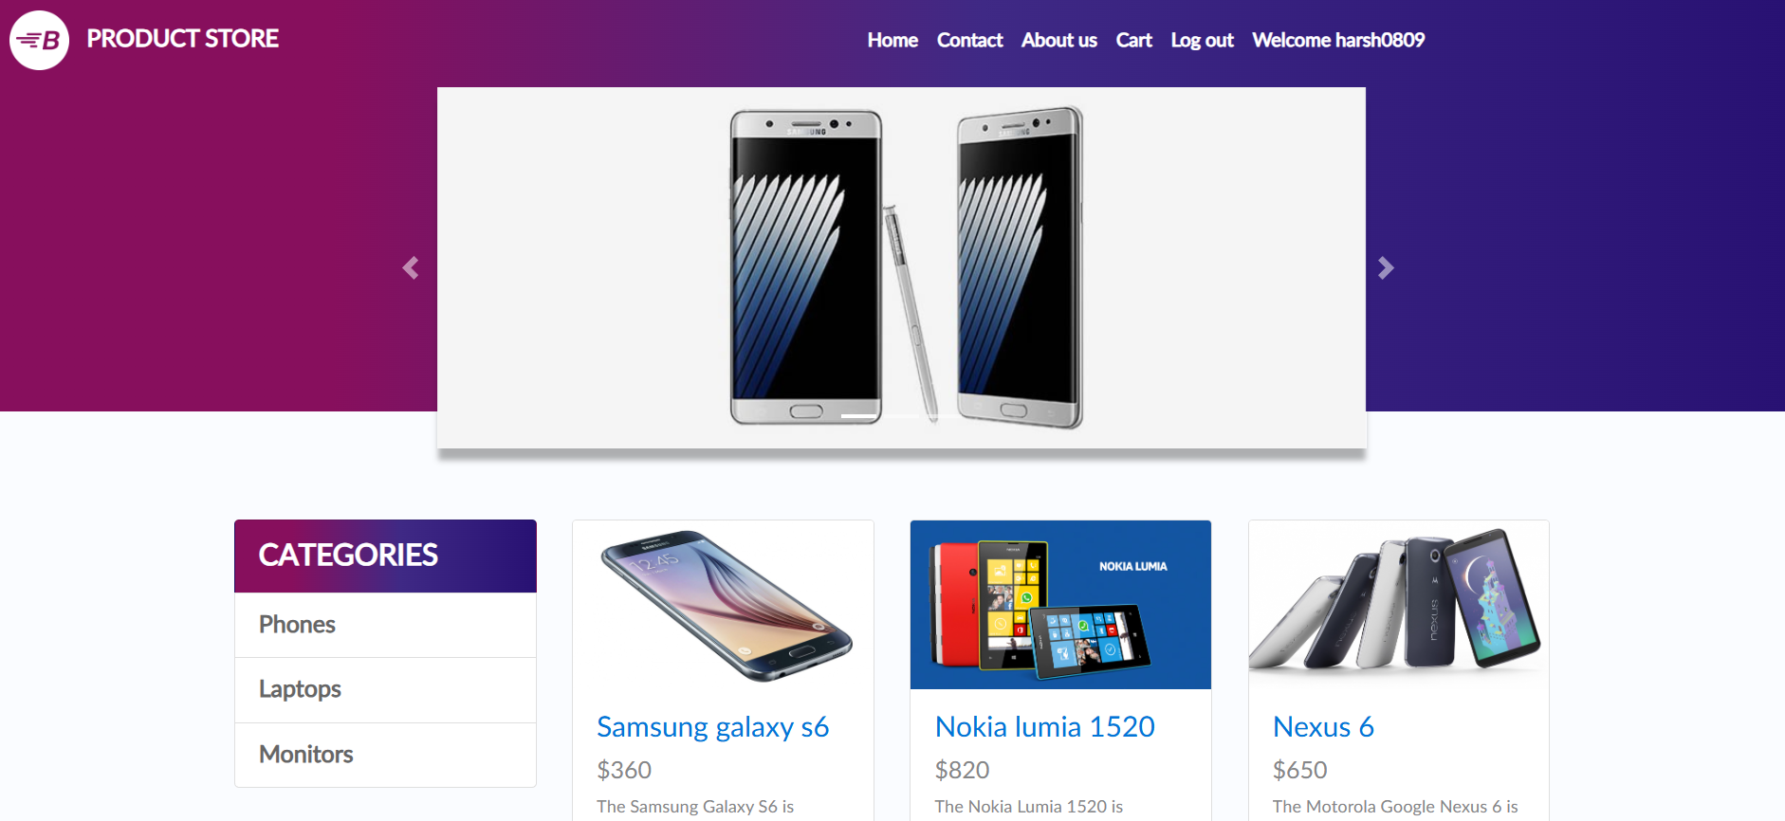
User Login
Objective: Verify a registered user can log into their account.
Steps: Navigate to the login page -> Enter valid credentials -> Click the login button.
Expected: The user is logged in successfully and redirected to the home or a profile page.

Slide 7
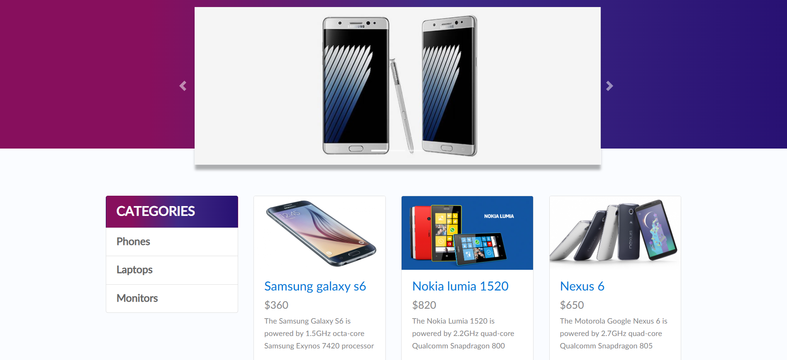
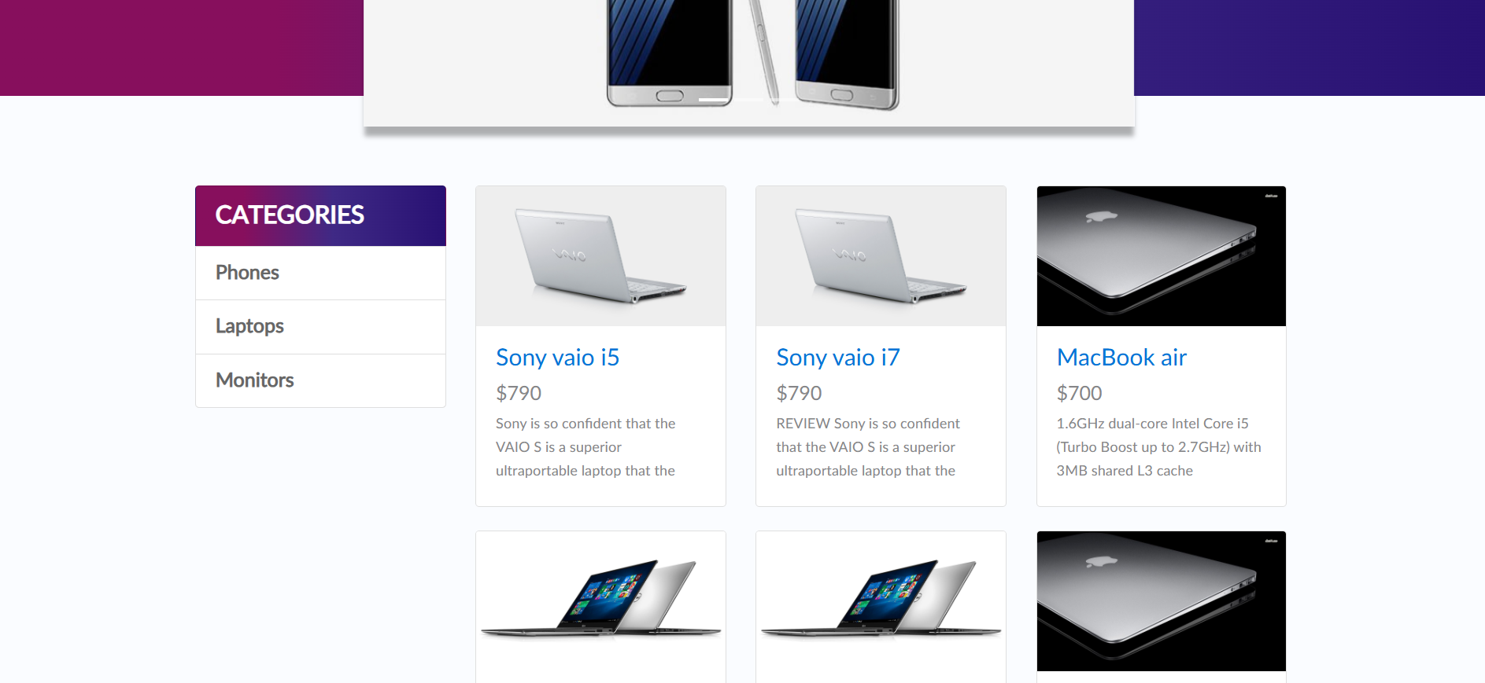
Navigate Categories
Objective: Verify the user can browse different product categories.
Steps: Click on a category link (e.g., "Laptops") from the menu -> View the products.
Expected: The page displays a list of products belonging to the selected category.

Slide 8
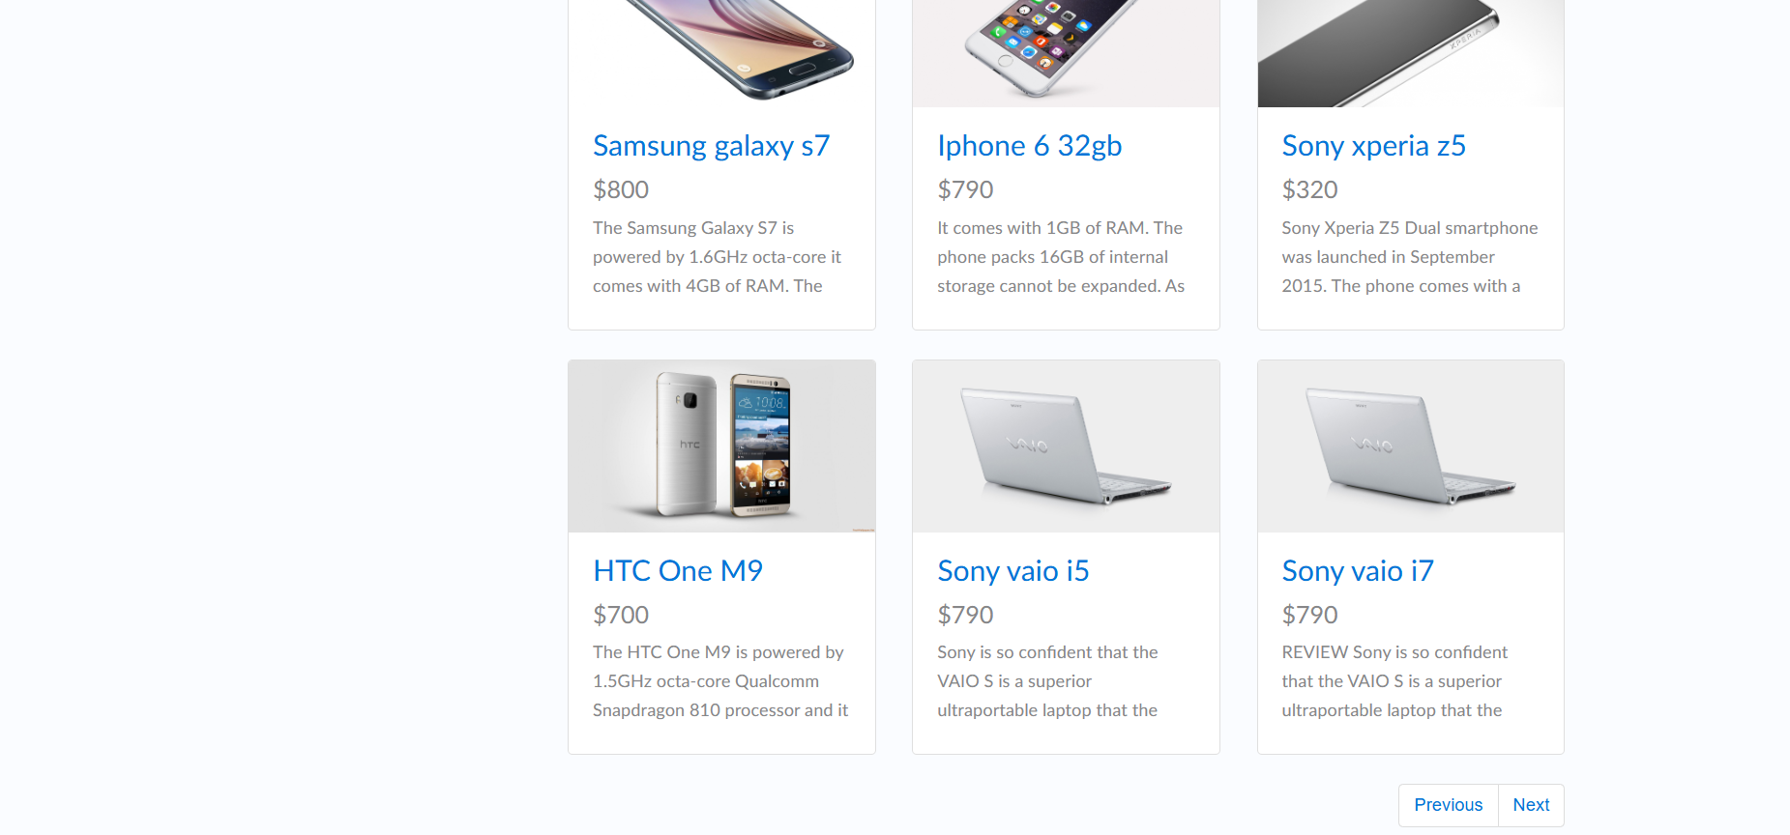
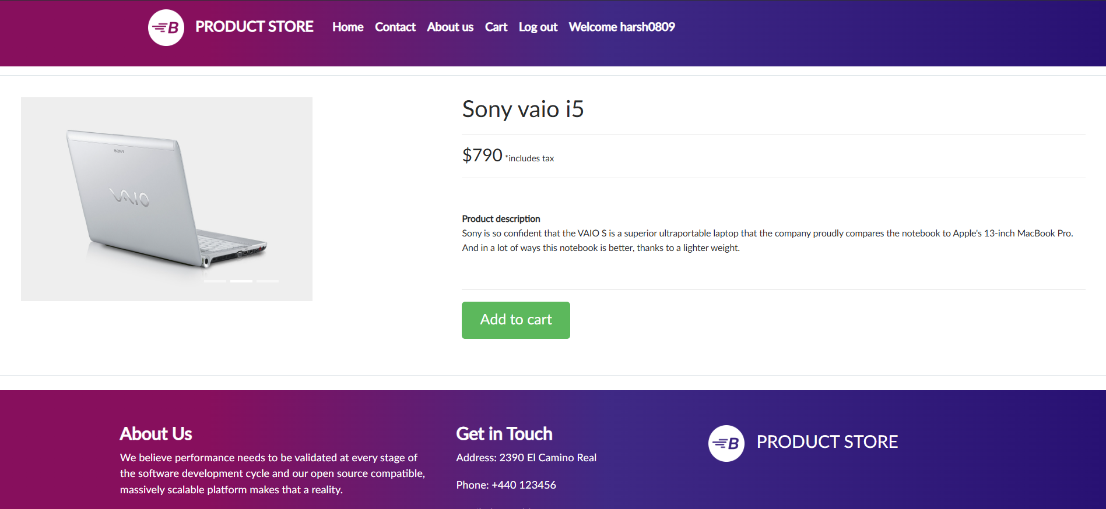
Select Product
Objective: Verify the user can view a product's details.
Steps: Navigate to a category page -> Click on a specific product.
Expected: The user is taken to the product details page with correct information (e.g., name, price).

Slide 9
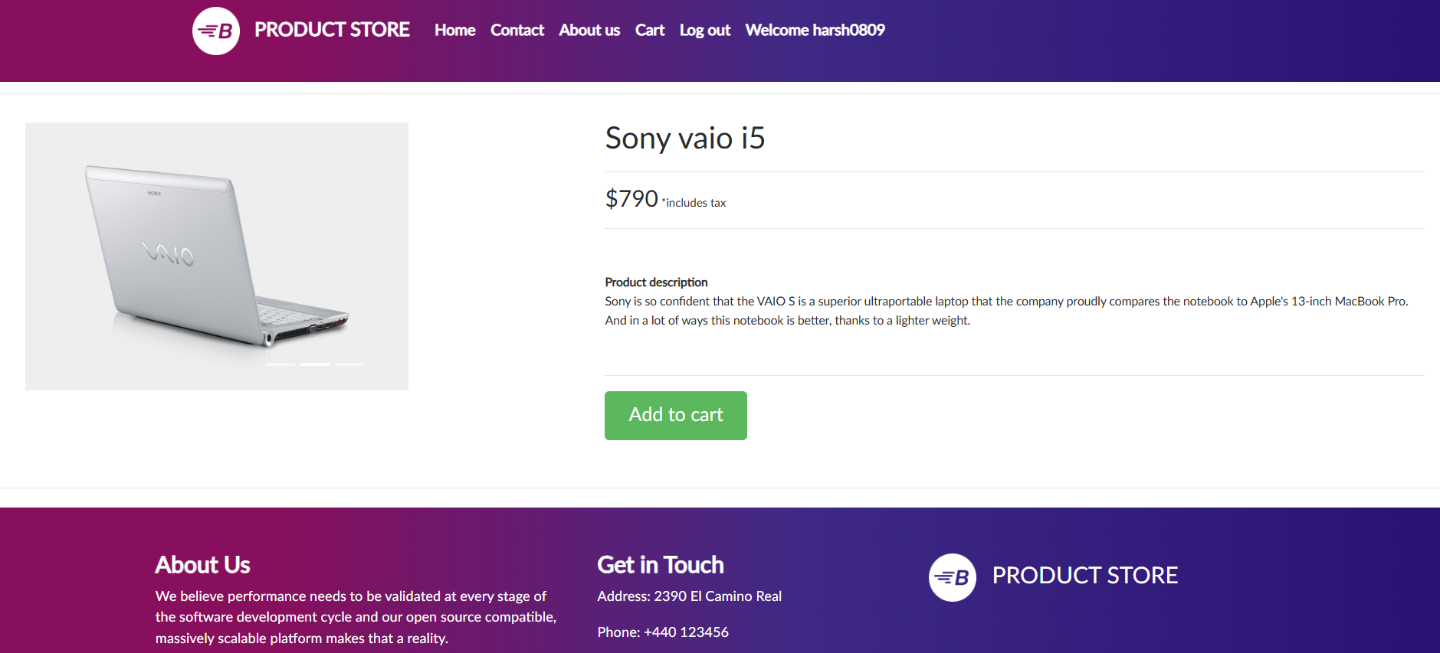
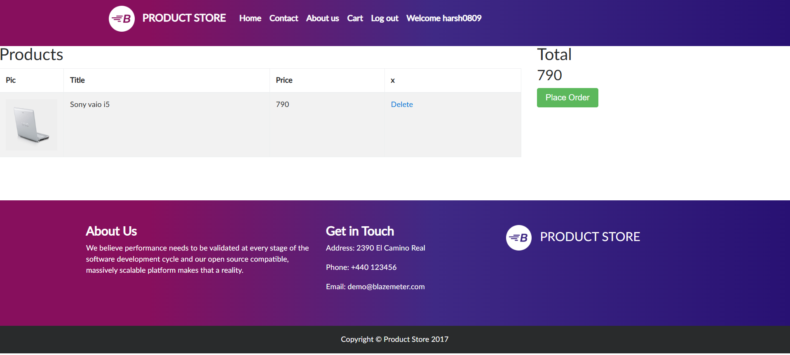
Add Product to Cart
Objective: Verify the user can add an item to their cart.
Steps: Navigate to a product page -> Click the "Add to Cart" button.
Expected: A confirmation message appears, and the product is added to the user's shopping cart

Slide 10
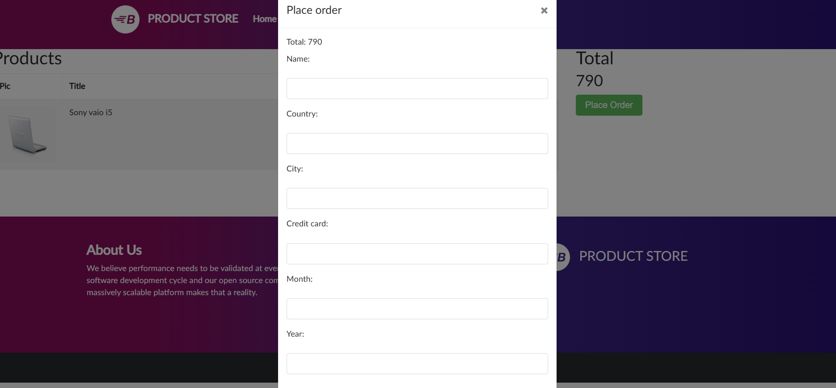
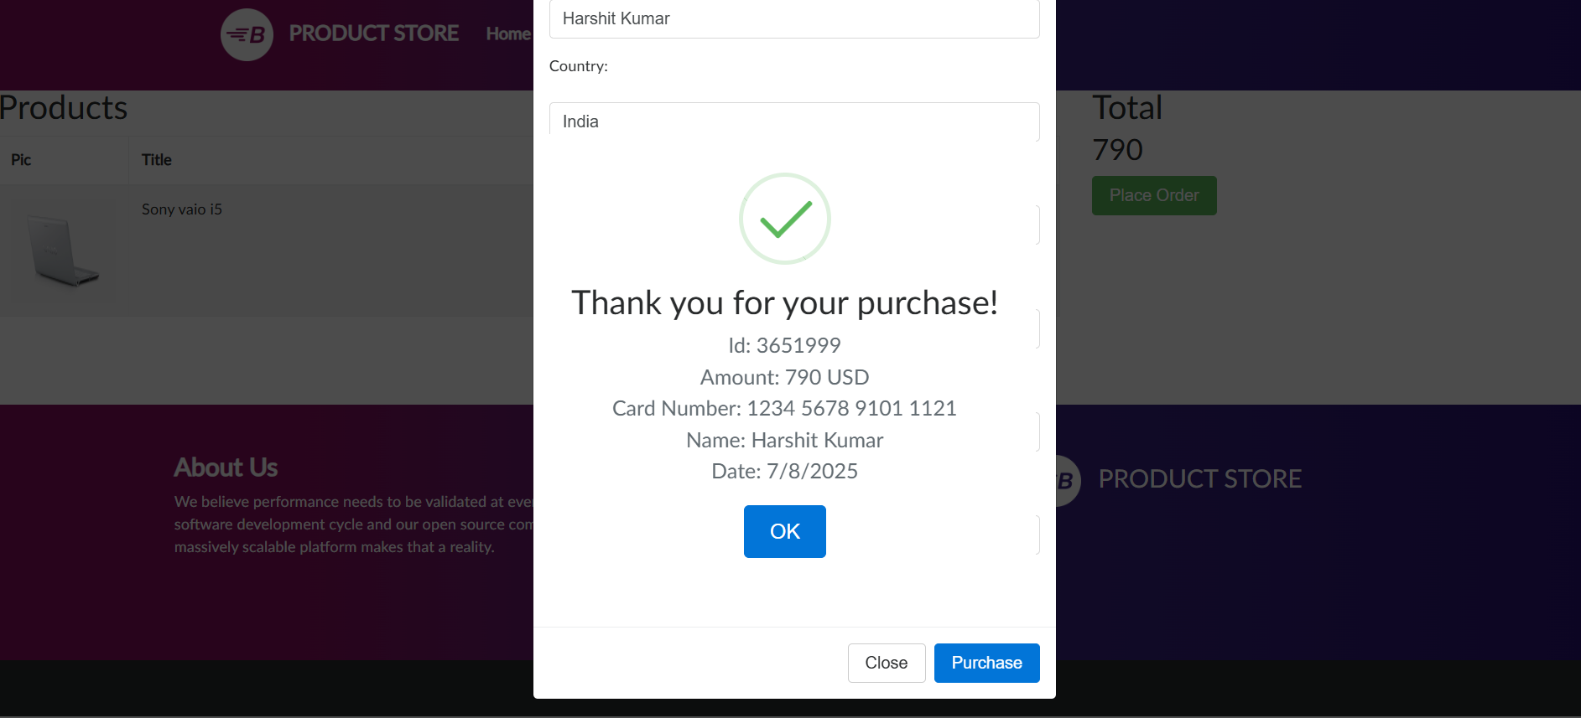
Place Order & Verify Confirmation
Objective: Verify the order placement process and confirmation.
Steps: Navigate to the cart -> Click "Place Order" -> Fill in the order form -> Submit.
Expected: The order is placed successfully, and a confirmation message with an order ID is displayed.

Slide 11
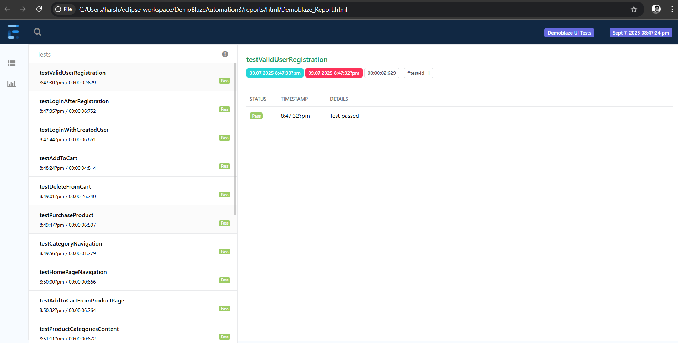
Test Report

Slide 12
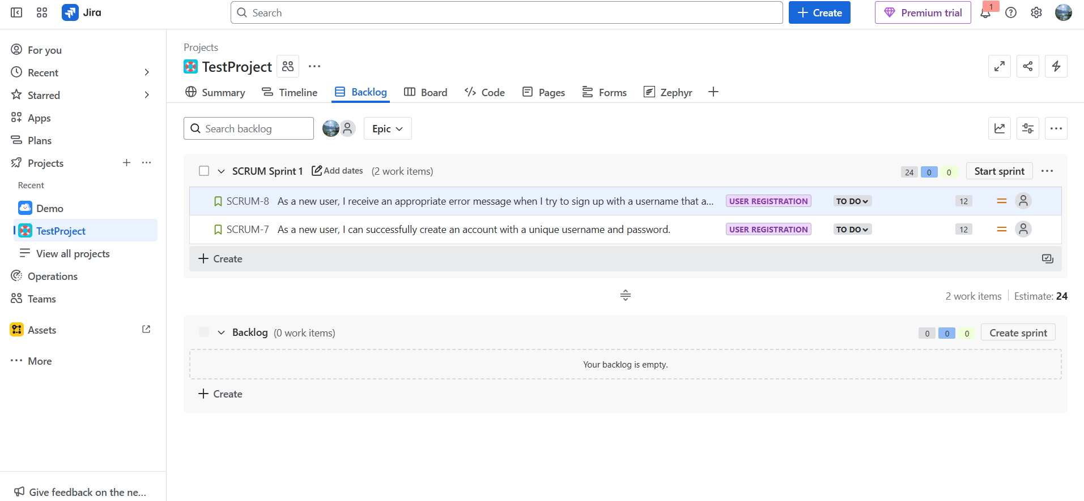
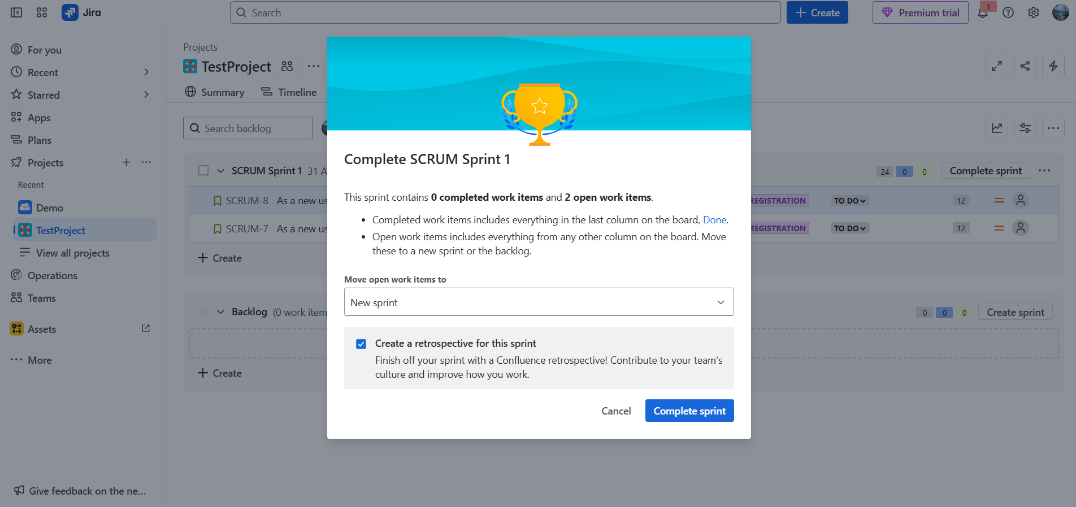
Using Jira for Project Management
What is Jira? It's a project management tool for tracking our work, from user stories to bugs.
How We Used It: We organized our automation tasks on a Jira board to track progress and manage our project effectively.
Benefit: It helps us stay organized and collaborate as a team.

Slide 13
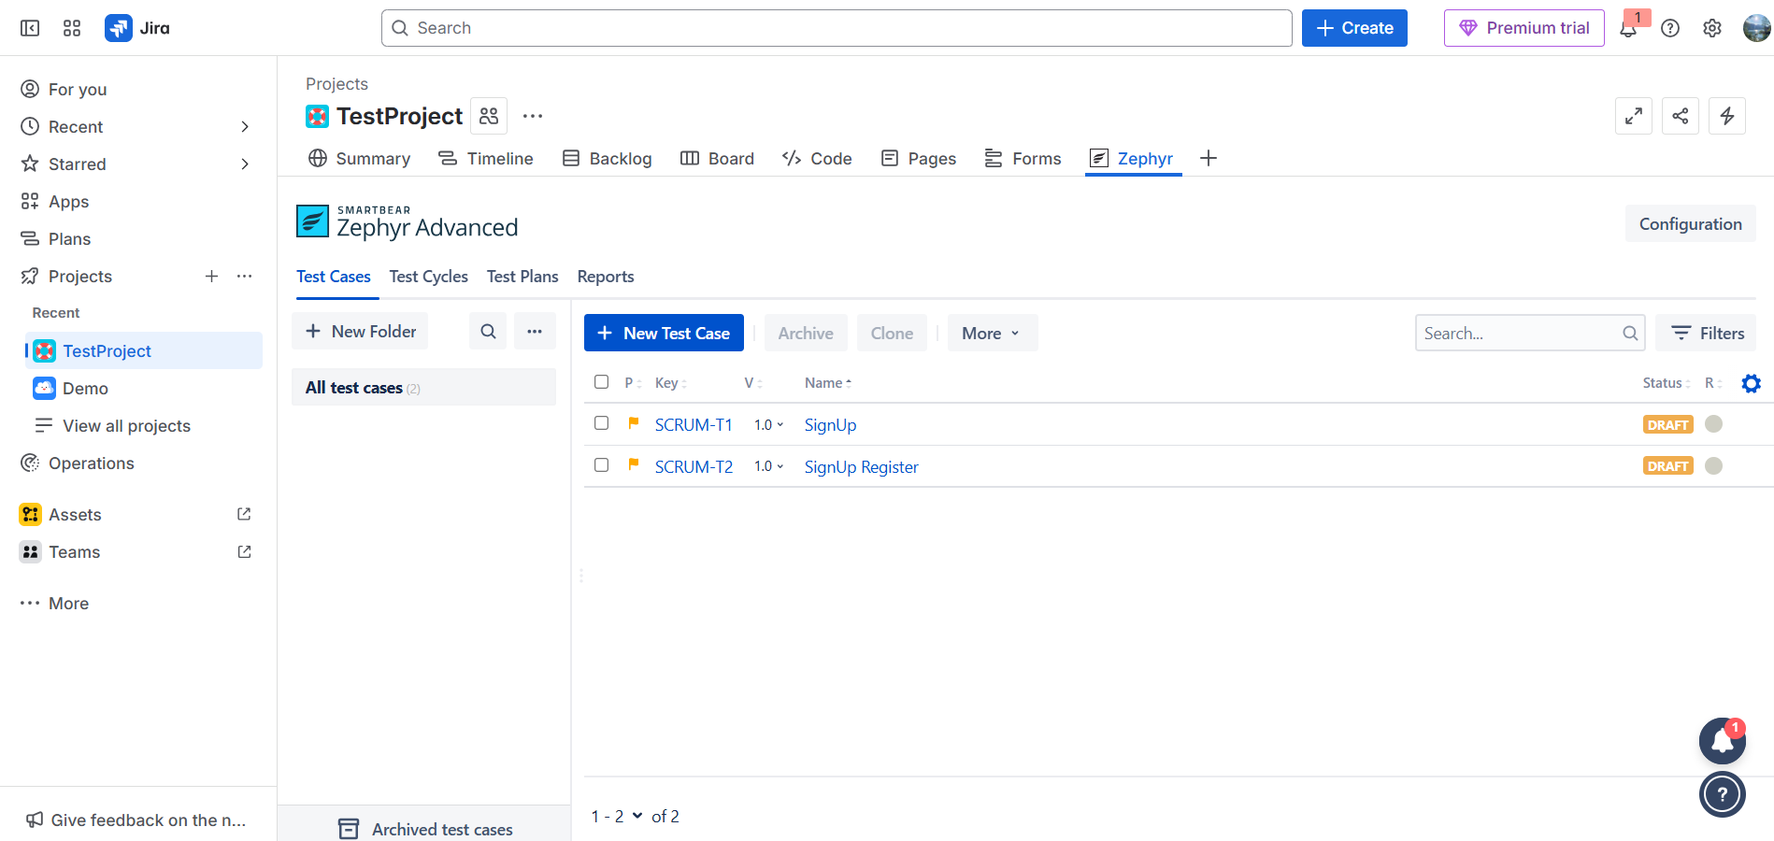
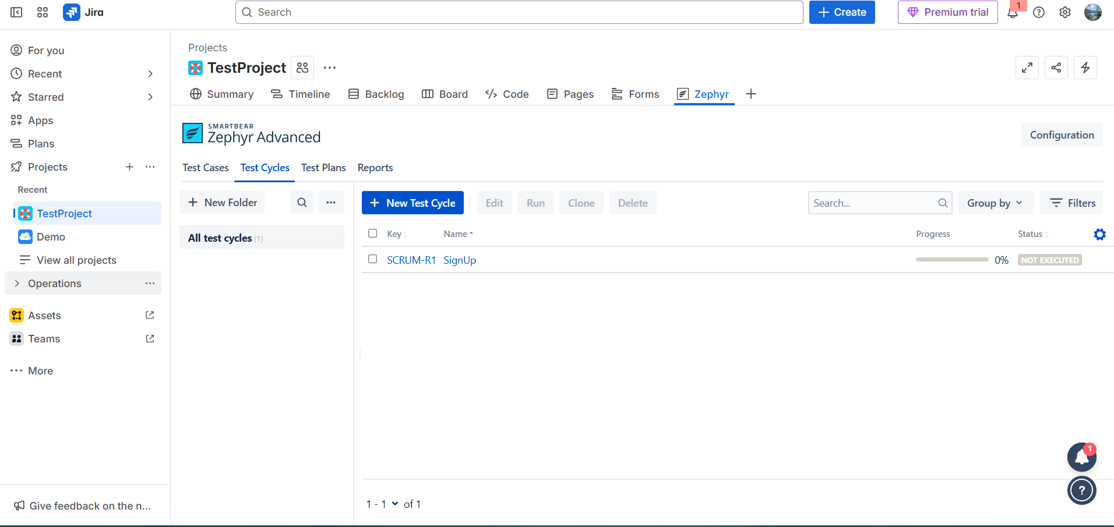
Introducing Zephyr for Test Management
What is Zephyr? It's a Jira add-on for managing our test cases.
How We Integrated It: We use Zephyr to create, execute, and report on our automated tests directly within Jira, linking them to specific features.
Benefit: It provides a clear overview of our test coverage and quality status in one central location.

Slide 14
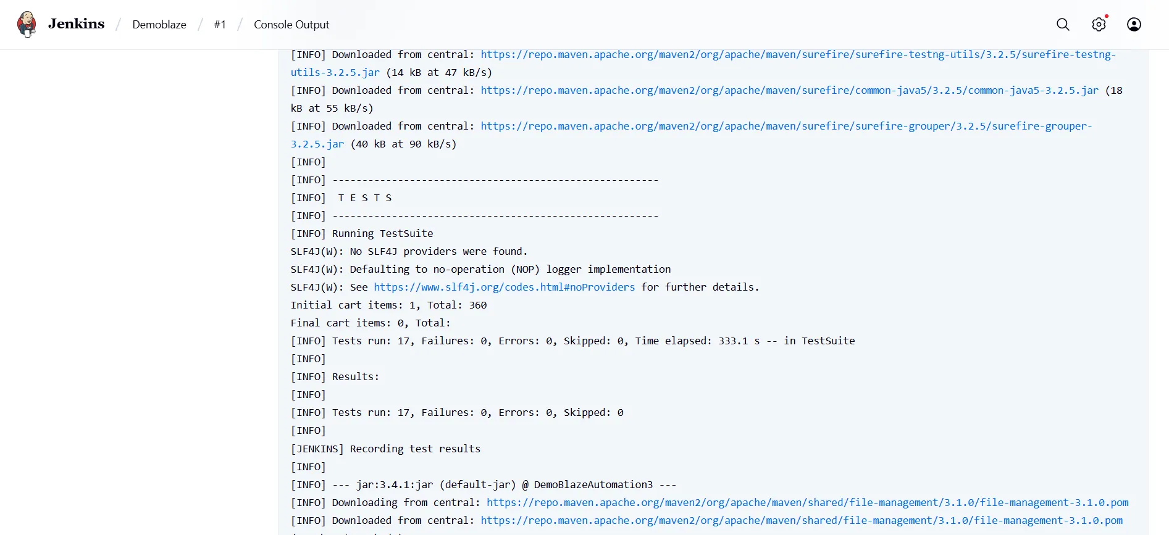
Introduction to Jenkins & Integration
What is Jenkins? It's an open-source automation server for building, testing, and deploying software. It automates key parts of the software development lifecycle, enabling continuous integration and continuous delivery (CI/CD).
Why We Use It: Jenkins automates our entire test workflow, ensuring tests run consistently without manual effort.
Our Integration: We've linked Jenkins to our GitHub repository. The Jenkins job is configured to automatically detect new commits and trigger a build, running our tests on the latest code.

Slide 15
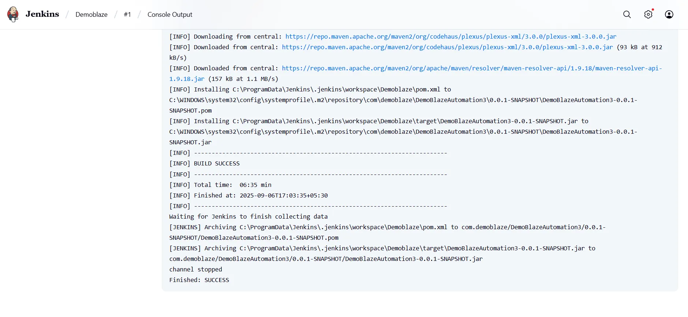
Jenkins Pipeline & Benefits
The Pipeline: Our pipeline has stages for getting code, running tests, and generating reports.
Benefits:
Faster Feedback: Issues are found and fixed more quickly.
Automation: Saves time and reduces manual effort.
Reliability: Ensures consistent and high-quality results.

Slide 16
Thank You

